Slide 1

Bill Generator by Python
Discover the power of Python in automating your billing process. Learn how to create a dynamic and customizable bill generator using Python's versatility.

Slide 2

Introduction
1
The Power of Automation
2
Python's Capabilities
Learn why Python is the perfect language for developing a bill generator, with its simplicity, readability, and vast library support.
Explore the benefits of automating your billing process, saving time, reducing errors, and improving efficiency.
3
Target Audience
Discover who can benefit from using a bill generator, from freelancers to small businesses, and even larger organizations.

Slide 3

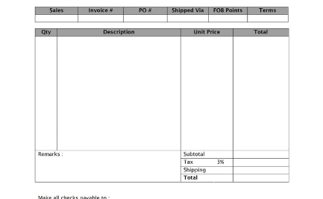
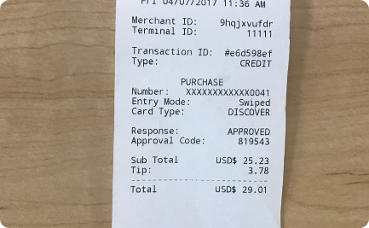
How the Bill Generator Works
Simple Input and Output
Total Calculation and Taxes
Multiple Output Formats
Get a step-by-step walkthrough of the bill generator process, from inputting data to generating a professionally formatted bill.
Learn how the bill generator calculates totals and handles taxes automatically, reducing the risk of human errors and ensuring accuracy.
Discover the flexibility of the bill generator, supporting various output formats such as PDF, HTML, and CSV for seamless integration with other tools.

Slide 4
Code Walkthrough
Modularity and Reusability
Handling Exceptions
Understand the structure of the bill generator code, with a focus on creating reusable functions and organizing code for scalability.
Learn how the bill generator gracefully handles unexpected errors and exceptions, ensuring a smooth user experience.
Integration with External APIs
Version Control and Collaboration
Explore how the bill generator can connect with external APIs to fetch relevant data, such as currency exchange rates or customer information.
Discover best practices for using version control to collaborate on the bill generator project with your team, ensuring seamless development.

Slide 5
Customization Options
1
Logo and Branding
Customize the bill template by adding your company logo and branding elements to provide a professional touch.
Flexible Layout Design
2
Explore different layout options, such as using tables or CSS styling, to adapt the bill generator's visual design to meet your specific needs.
3
Localization and Internationalization
Learn how to modify the bill generator to support different languages, regional formats, and currency symbols to cater to a global audience.

Slide 6



Implementing the Bill Generator in Other Projects
Modular Code Integration
Collaborative Development
API Integration and Scalability
Discover how you can easily integrate the bill generator's functionality into existing Python projects, saving time and effort in development.
Learn best practices for incorporating the bill generator into team projects, enabling seamless collaboration and code reuse across different applications.
Explore ways to expose the bill generator's functionality as an API, allowing other applications to utilize its capabilities efficiently.

Slide 7

Potential Use Cases
1
Freelancers and Independent Contractors
2
Small Businesses and Startups
Discover how the bill generator can benefit small businesses and startups by automating billing processes and improving overall financial management.
See how the bill generator can streamline invoicing for freelancers and independent contractors, enabling efficient payment tracking and client communication.
3
Non-Profit Organizations and Charities
4
Web Development Agencies
Learn how the bill generator can be integrated into web development agencies' workflow, simplifying client billing and project financial tracking.
Explore how the bill generator can assist non-profit organizations and charities in generating donation receipts and managing donor information effectively.

Slide 8

Conclusion
Reflect on the journey of creating a bill generator using Python, its advantages, and how it can revolutionize your billing processes. Empower your future projects with this versatile tool.

